Slide 1
Process Intensification through Coflore Reactors
Dr Gilda Gasparini
Process Intensification 2012
Newcastle upon Thyne
2nd May 2012

Slide 2
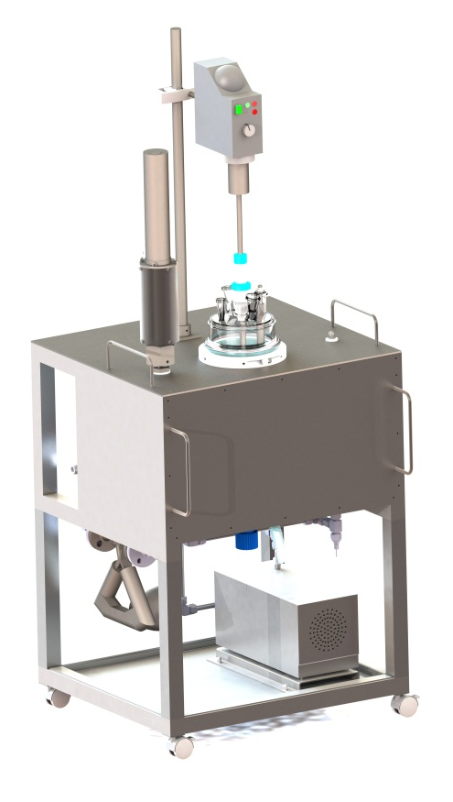
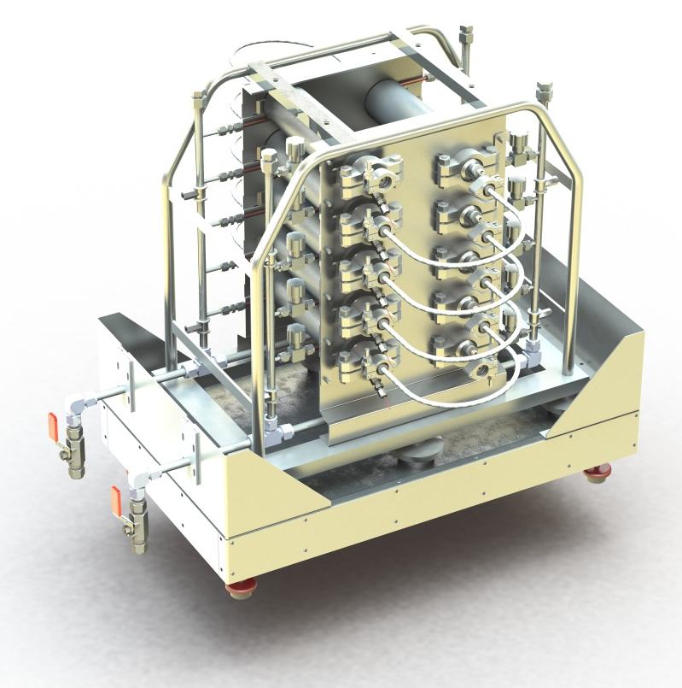
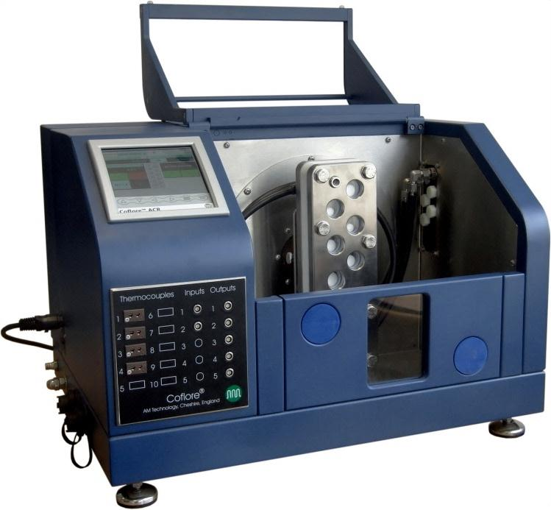
AM Technology
Based in the UK
Founded in 2000
Manufacture chemical reactors
Strong focus on innovation

Slide 3
Flow reactors – benefits compared to batch reactors
Improved reaction time control
Simultaneous feed/discharge/heating/cooling
Optimum separation of reactants and products
Reactor does not store reacted material
Reduced reaction time
Higher reactant concentration
Higher heat transfer capacity
Improved safety for hazardous reactions
Improved mixing
More extreme temperatures can be employed for shorter periods
Orderly flow
Improved yields/purity
Reduced equipment size/cost
Reduced solvent use
Increased output flexibility
Faster scale up
Improved energy efficiency

Slide 4
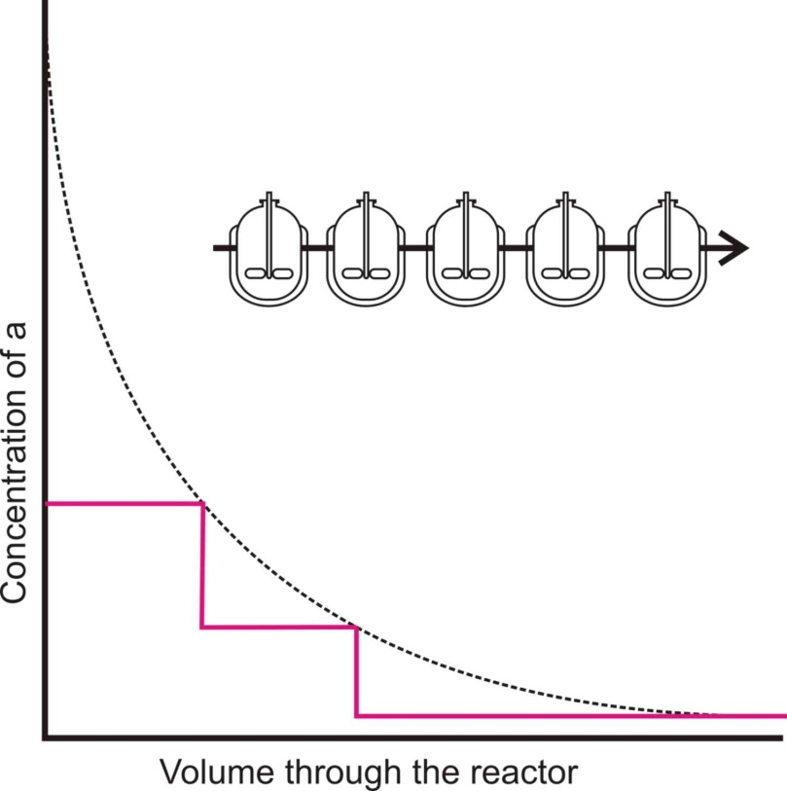
Coflore design principle
CSTRs in series
Increased flexibility
Residence time
multi phase (G/L, S/L)
Low pressure drop
cheaper pump
Easy scale up
Dynamic mixing
Multistage for orderly flow

Slide 5
Designing dynamically mixed flow reactors
Conventional rotating stirrers are poorly suited to flow reactors
High capital/maintenance cost of mechanical seals
Single mechanical seals leak product out
Double mechanical seals leak product in
High axial mixing
Long (multi impeller shafts) shafts create stability problems
Centrifugal separation problems (two phase mixtures)
Baffles are difficult to design and install

Slide 6
Coflore – Transverse Mixing
Efficient radial mixing
No baffles (self baffling)
No seals or magnetic couplings
No centrifugal effects
No shaft stability problems

Slide 7
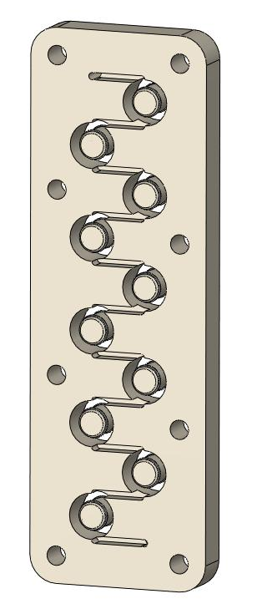
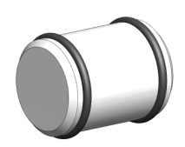
Coflore ACR – Lab scale
Lab scale
Ten reaction cells cut within a monolithic block
Discharge
Reaction cell
Inter-stage channel
Product flow
Agitator
Feed

Slide 8
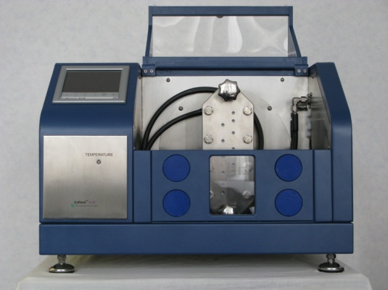
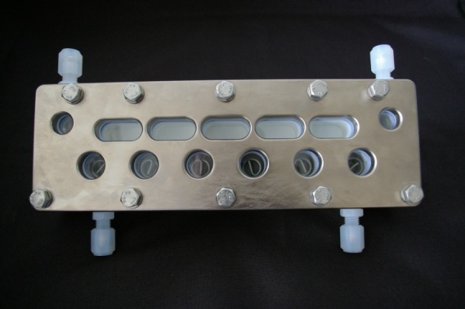
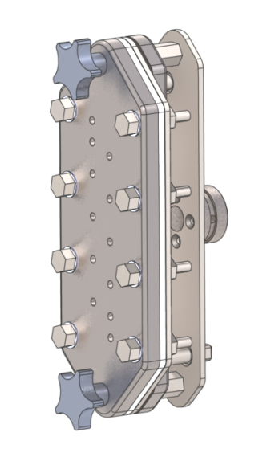
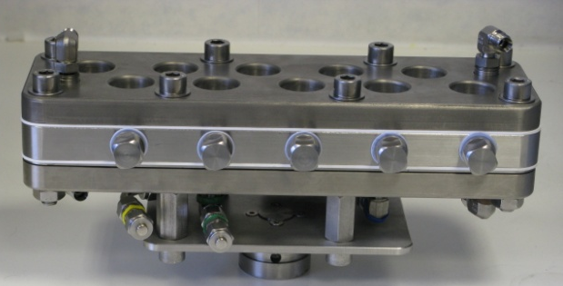
Coflore ACR – Lab scale
The bench top shaker platform can handle a range of reactor blocks
Patents pending
Counter current reactor block
Standard 100 millilitre reactor block
Standard 10 millilitre reactor block

Slide 9
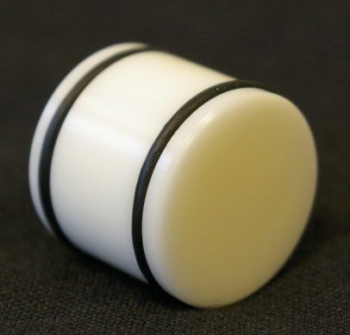
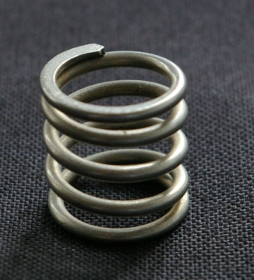
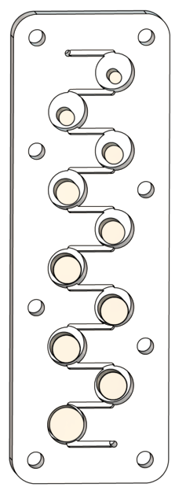

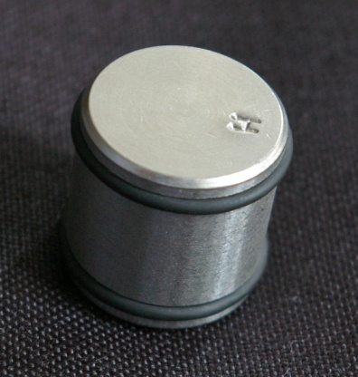
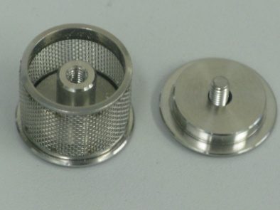
Coflore ACR – Lab scale
Interchangeable agitators for different applications and controlling cell volume
Control RTD and surface to volume ratio with different diameter agitators
Ceramic agitator
Spring agitator for two phase mixtures
Basket agitator for handling catalyst
Hastelloy agitator

Slide 10
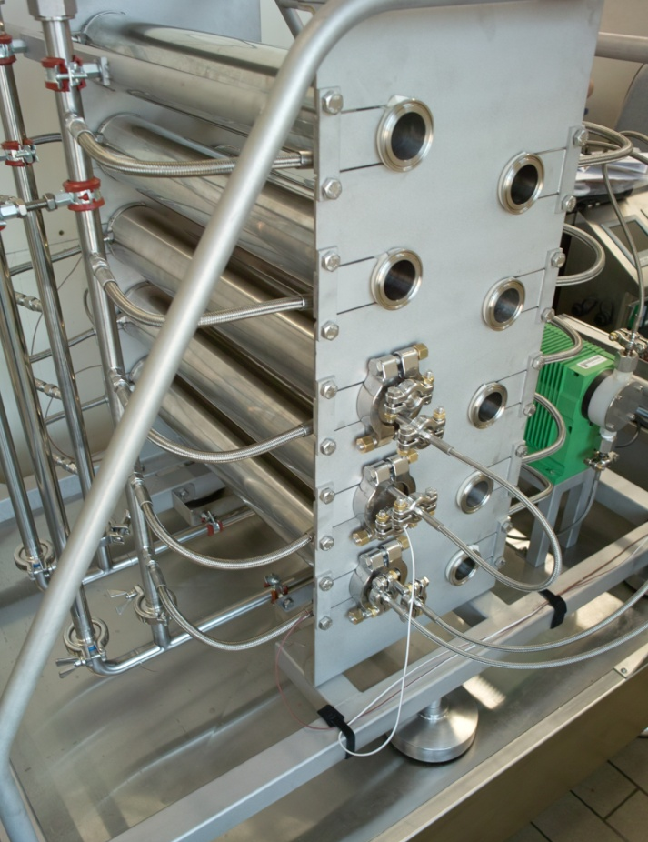
Coflore ATR – Industrial scale
Industrial scale Coflore systems use the same mixing technique but the reaction cells are expanded into long tubes
Operating capacity - 1 to 10 litres
10 temperature control zones
High design pressure/temperature
Low pressure drop
High mixing efficiency
Patents pending
Patents pending

Slide 11
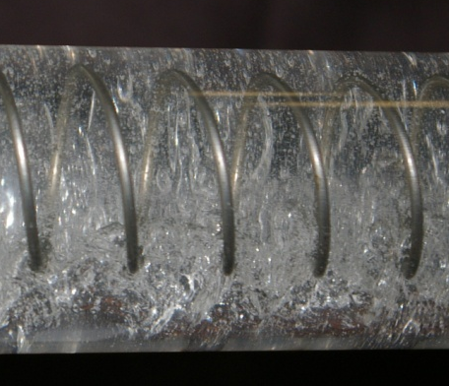
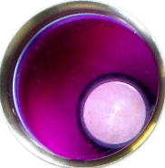
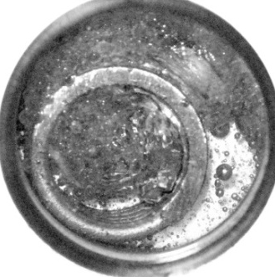
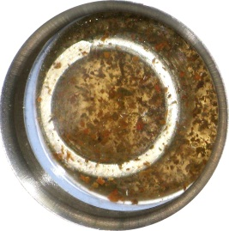
Coflore Design - Mixing
mixing
Liquid homogeneous | Equivalent to static mixer at 4 m/s
L/L | Equivalent to ½ litre batch at 400 rpm
G/L | > 1 l batch at 600 rpm
G/L/S | 5 times better than 100 ml batch
Homogenous liquids
Gas/liquid mixtures
Slurries

Slide 12
Coflore – Applications
List of reactions:
Hoffman reaction
Suzuki reaction
Bourne reaction
Nitration
Polymerisations
Grignard reactions
De-hydrogenations
Bu-Li
Solid handling:
PVA particles, 50-200 µm, 30% concentration
Alumina particles, 50-200 µm, 10%
Caesium carbonate, up to 10%
Precipitation of NaCl up to 25%
Precipitation of hydroiodide salt of N-iodomorpholine
Semicarbazone synthesis
Nanoparticles clumps
Pd/Al₂O₃ retained in the block
Enzyme in whole cells
Crystallisation of CaCO₃
Crystallisation of glycine

Slide 13
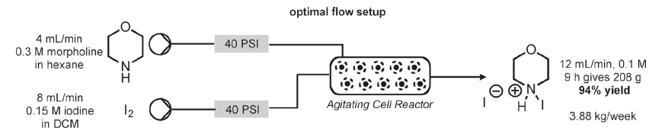
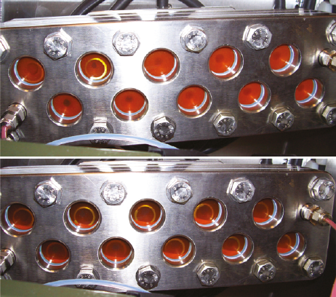
Coflore – Solid handling
Browne, D., et al., Continuous Flow Processing of Slurries: Evaluation of an Agitated Cell Reactor, OPRD, 2011, 15 (3), pp 693–697

Slide 14
Coflore Design – Solid handling
Browne, D., et al., Continuous Flow Processing of Slurries: Evaluation of an Agitated Cell Reactor, OPRD, 2011, 15 (3), pp 693–697

Slide 15
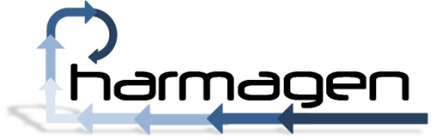
Coflore – test results
API: Gabapentin
Hofmann Degradation

Slide 16
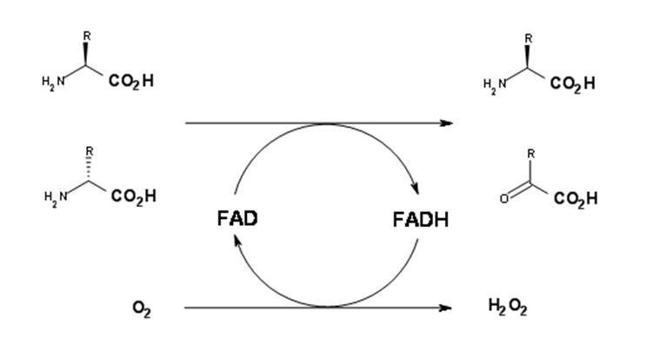
Biocatalytic oxidase
DL – amino acid resolution:
Production of L – amino acids and α – keto acid.
Move away from using a batch process towards a continuous system.
G/L/S system.
> 24 hours reaction time
Enzyme as a slurry, loaded on whole cells.

Slide 17
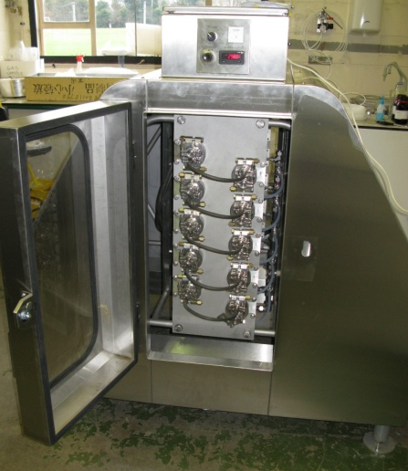
Biocatalytic oxidase
Flow - 1 litre ATR (<120 strokes pm mixer)
Batch - 1 litre (400 rpm mixer)
1-10 litre ATR flow reactor

Slide 18
Biocatalytic oxidase
Flow - 1 litre ATR (<120 strokes pm mixer)
Flow - 10 litre ATR (<120 strokes pm mixer)
(70% less oxygen)
Batch - 4 litre batch (400 rpm mixer)
Batch - 1 litre (400 rpm mixer)
1-10 litre ATR flow reactor

Slide 19
Biocatalytic oxidase
Continuous makes this process scalable
LCA data: 10 L continuous vs 10 1L batch cycles
88% reduction in kWh/L consumption
90% reduction in CO2 production
Energy consumption and CO2 production increase more slowly in continuous than batch
even more benefits will be achieved at larger scale
1-10 litre ATR flow reactor

Slide 20
Biocatalytic oxidase
10 – 80 ml ACR flow reactor

Slide 21
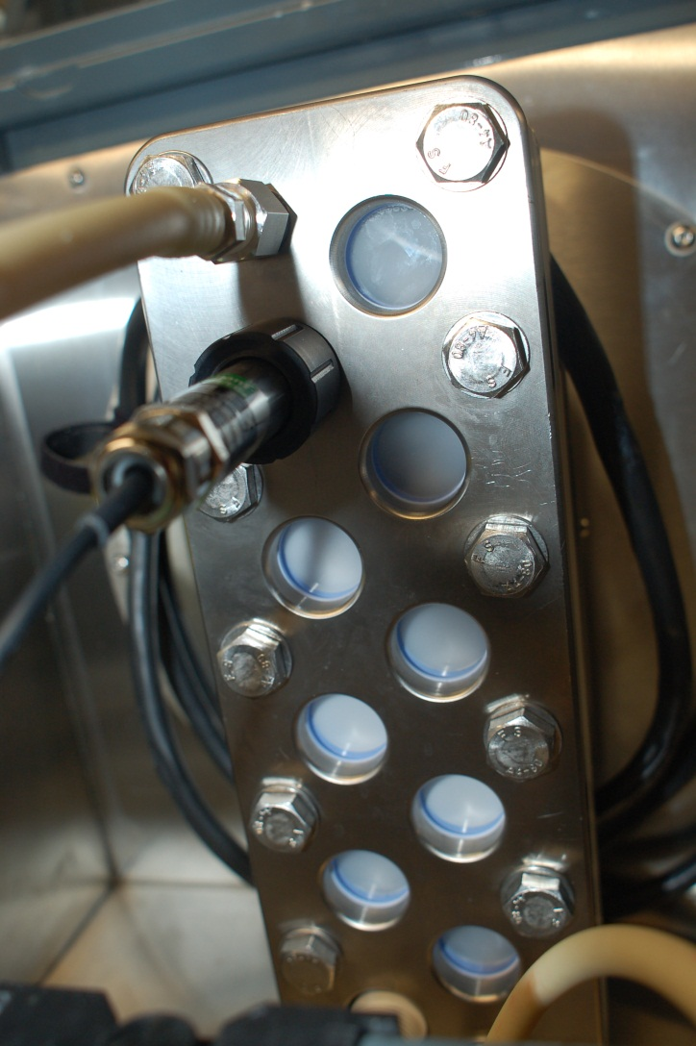
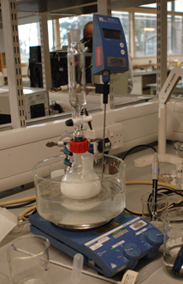
Continuous crystallisation – preliminary results
Calcium carbonate crystals
CaCl₂ + Na₂CO₃ CaCO₃ + 2NaCl
ACR 100, 10 ml/min
Test run = 3 hours, consistent particle size
Tests performed by CMAC

Slide 22
Continuous crystallisation – preliminary results
Calcium carbonate crystals
CaCl₂ + Na₂CO₃ CaCO₃ + 2NaCl
ACR 100, 10 ml/min
Test run = 3 hours, consistent particle size
Tests performed by CMAC

Slide 23
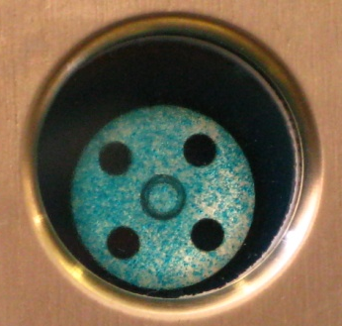
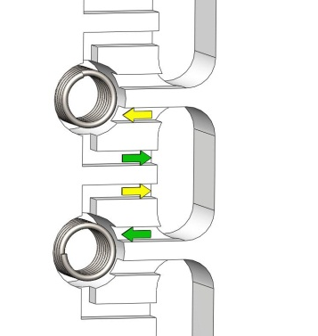
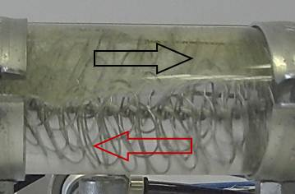
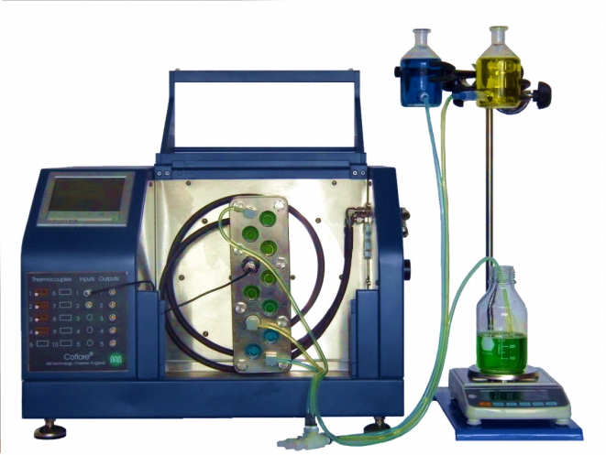
AMT focuses
Solid handling
Work up – Counter current extraction
Pump selection – Gravity feed

Slide 24
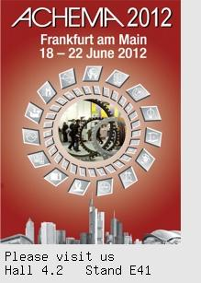
Thank You!
Mixing independent of throughput
Age segregation of products
Scale-ability
Multi-phase handling
From 10 ml to 10 litres volume

