Slide 1
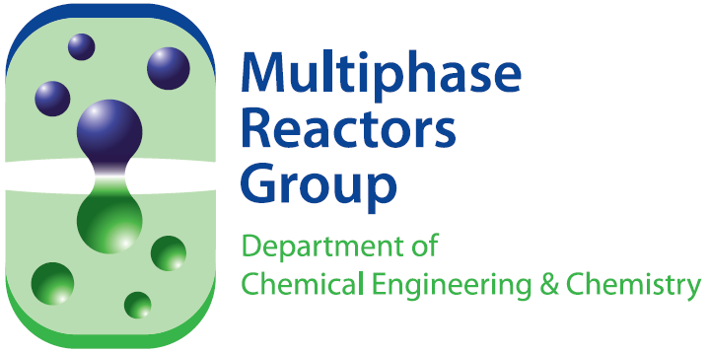
Design of Catalytic Membrane Reactor for Oxidative Coupling of Methane
A. S. Chaudhari
F. Gallucci
M. van Sint Annaland
Chemical Process Intensification – Department of Chemical
Engineering and Chemistry - TU/e – The Netherlands
Technical session 3
Process Intensification, May 2, 2012

Slide 2
Outline
Introduction
Design of catalytic membrane reactor
  Packed bed membrane reactor
  Hollow fiber catalytic membrane reactor
Results
Conclusions

Slide 3
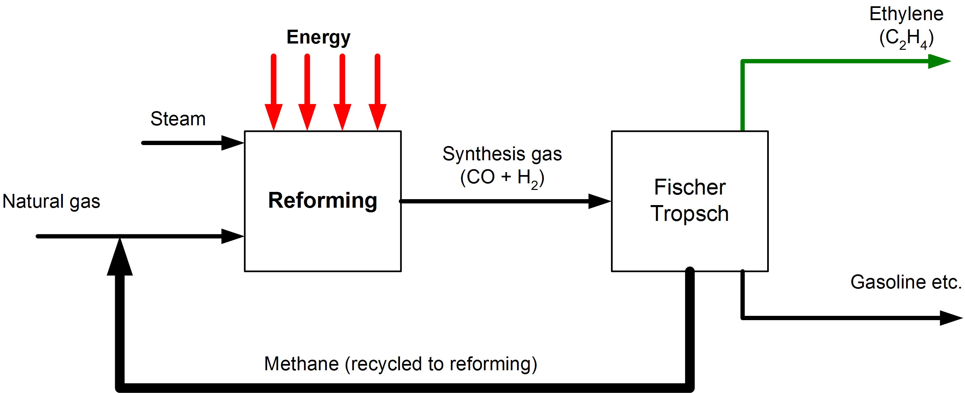
Introduction
Ethylene production
Production of ethylene from natural gas
Indirect conversion route (GTL)
Synthesis gas (CO, H₂) via steam reforming of methane (SRM)
Fischer-Tropsch gives higher hydrocarbons
Direct conversion route
Oxidative coupling of methane (OCM) to ethylene
2 CH₄ + O₂ C₂H₄ + 2H₂O

Slide 4
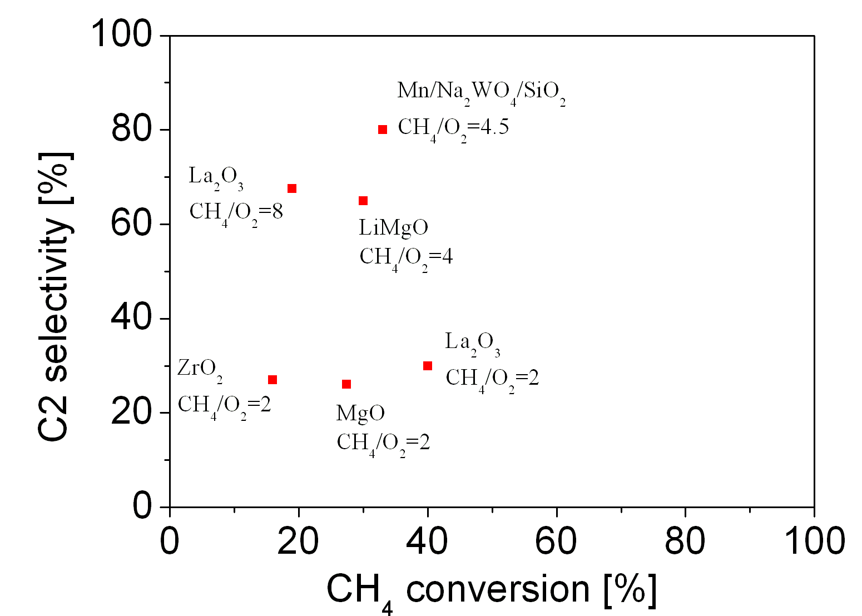
Introduction contd…
Production of ethylene via oxidative coupling of methane [OCM]
2 CH₄ + O₂ C₂H₄ + 2H₂O
CH₄ + 2O₂ CO₂ + 2H₂O
C₂H₄ + 3O₂ 2CO₂ + 2H₂O
Typical conversion-selectivity
problem
Highly exothermic
Large methane recycle
Maximum C₂ yield < 30%

Slide 5
Kinetics of OCM
Reaction scheme
Formation rates of C₂H₄, C₂H₆ and CO₂ (primary reactions)
2 CH₄ + ½ O₂ → C₂H₆ + H₂O
n = 1.0
m = 0.352
CH₄ + 2 O₂ → CO₂ + 2 H₂O
n = 0.587
m = 1
Distributive O₂ feeding = membrane reactor
Notes:
Aanpassen: stap voor stap
4

Slide 6
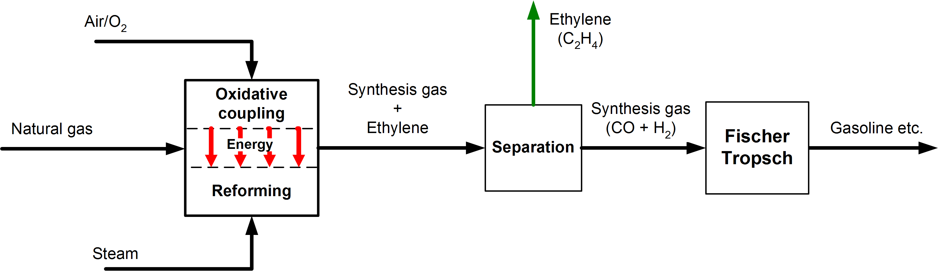
Novel Process Design
Design a possible autothermal process in single multifunctional reactor
  Integration of exothermic OCM and endothermic steam reforming of methane (SRM) → ΔHtot = 0
  Advantages:
    Increase methane utilization/conversion
    OCM/SRM → Ethylene/synthesis gas production
    Optimal heat integration
Present investigation

Slide 7
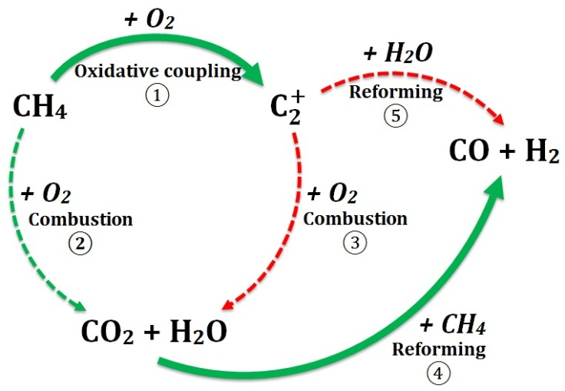
Integration of OCM and SRM
  CH₄ + ½ O₂ → ½ C₂H₄ + H₂O ΔH_{r} = -140 kJ/mol
  CH₄ + 2 O₂ → CO₂ + 2 H₂O ΔH_{r} = -801 kJ/mol
  Combustion of ethane/ethylene
  CH₄ + H₂O ⬄ 3 H₂ + CO ΔH_{r} = 226 kJ/mol
  Reforming of ethane/ethylene

Slide 8
Outline
Introduction
Design of catalytic membrane reactor
  Packed bed membrane reactor
  Hollow fiber catalytic membrane reactor
Results
Conclusions

Slide 9

Possible packed bed membrane reactor configurations for only OCM
Pre mixed adiabatic: very low C₂ yield for the high temperature and O₂ concentration
CH₄ + O₂
cooling
Pre mixed : low C₂ yield at high O₂ concentration
CH₄ + O₂
O₂
Distributive feeding: low C₂ yield for
high temperature
CH₄
O₂
Distributive feeding with cooling
(Virtually isothermal):Highest yield →
Extremely complicated reactor design
CH₄
cooling

Slide 10
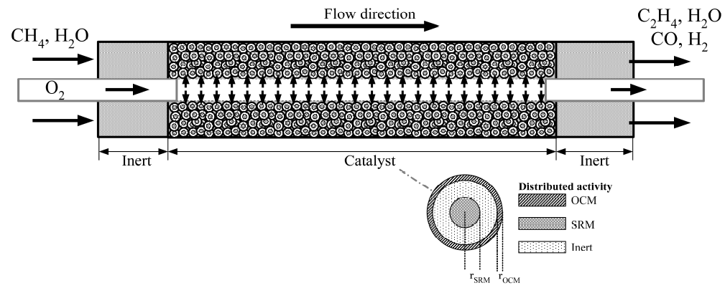
Packed bed membrane reactor concept
OCM
SRM
Cooling on particle scale
Dual
function
catalyst
particle
Packed Bed membrane Reactor
  Two cylindrical compartments separated by Al₂O₃ membrane for O₂ distribution

Slide 11
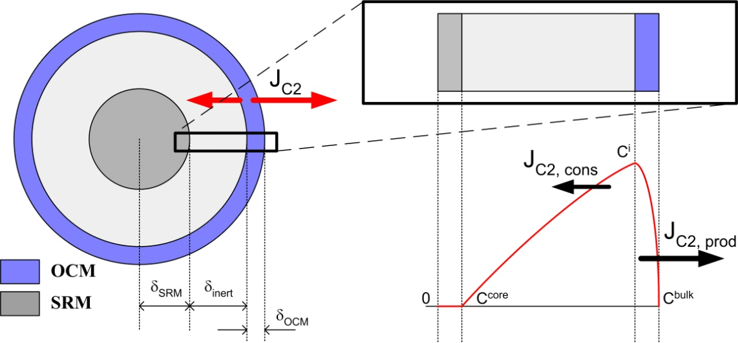
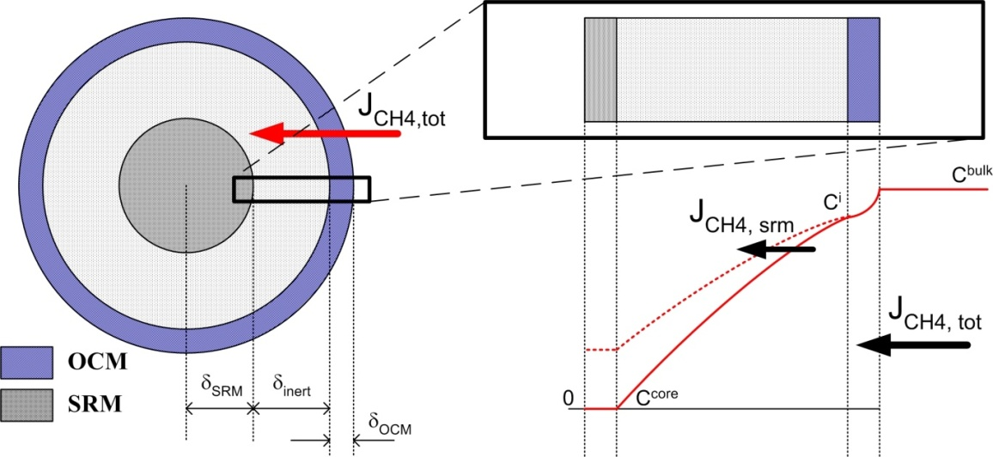
Integration on particle scale
Complete conversion of O₂ at OCM layer
0
R
Preventing C₂ mole flux to the particle centre
Influencing CH₄ mole flux to the particle centre

Slide 12
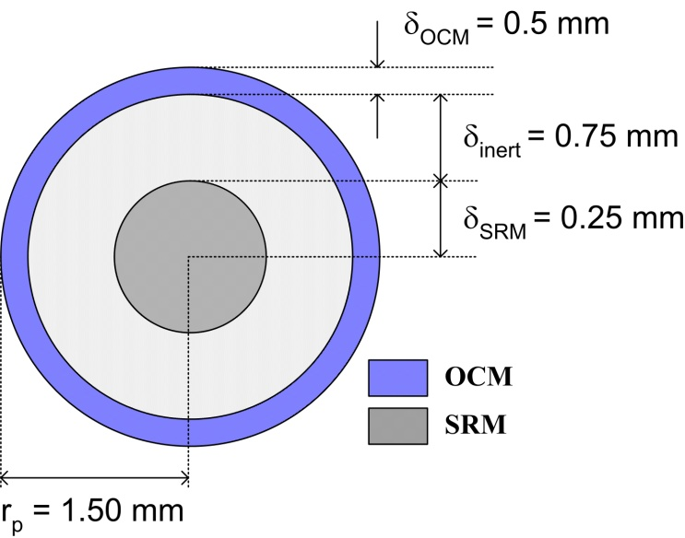
Numerical model: Particle scale
Intraparticle reaction model
Optimize the catalyst particle
  Thickness of OCM catalytic layer
  Thickness of SRM catalytic layer
  Thickness of inert porous layer
  Diffusion properties viz. porosity and tortuosity
Advantages:
  Strong intraparticle concentration
  profiles
  Beneficial for C₂ selectivity
  Vary r_{SRM}: autothermal operation
Kinetics from:
OCM: Stansch, Z., Mleczko, L., Baerns, M. (1997) I & ECR, 36(7), p-2568.
SRM: Nimaguchi and Kikuchi(1988). CES, 43(8), p-2295

Slide 13
Outline
Introduction
Design of catalytic membrane reactor
  Packed bed membrane reactor
  Hollow fiber catalytic membrane reactor
Results
Conclusions

Slide 14
Integration on single catalyst particle
Results – influence on performance
Methane consumption by dual function catalyst particle
Influence on CH₄ conversion
  ~50% increase (Vs. OCM)
Reforming diffusion limited
  SRM flow = f(X_{CH4})
  Presence sufficient H₂O
  Proportional to ε/τ or δ_{SRM}
Input: X_{CH4} = 0.4; X_{O2} = 0.005; X_{H2O} = 0.5, r_{SRM} = 0.5mm, r_{OCM} = 0.5mm, r_{p} = 1.5mm

Slide 15
Integration on single catalyst particle _{contd…}
Results – CO_{x} production
CO_{x} production
  Large contribution of SRM
  OCM contrib. low →low p_{O2}
Reforming diffusion limited
  Mainly CO production
  WGS on OCM cat → CO₂
  Strong decrease by δ_{OCM}
Loss of C₂ products by
reforming?
Input: X_{CH4} = 0.4; X_{O2} = 0.005; X_{H2O} = 0.5, r_{SRM} = 0.5mm, r_{OCM} = 0.5mm, r_{p} = 1.5mm

Slide 16
Integration on single catalyst particle _{contd…}
Input:
X_{CH4} = 0.4; X_{O2} = 0.005; X_{H2O} = 0.5, r_{SRM} = 0.5mm,
r_{p} = 1.5mm
Losses of C₂ to reforming core
  Negligible (Maximum 3% ) at reactor inlet conditions
What about the energy balance?

Slide 17
Integration on single catalyst particle _{contd…}
Results: Energy production → OCM/SRM particle Vs only OCM particle
  Variation of ε/τ ratio at constant r_{SRM}:
Distributed feeding of O₂ → Q_{tot} < 0.3 W → makes dual function catalysis possible
Autothermal operation is possible → ε/τ = 0.01-0.08
Other options: Variation of r_{SRM}, steam concentration
Input:
X_{CH4}=0.4; X_{H2O}=0.5
T = 800 C; P = 150kPa; r_{OCM}=0.25mm;
r_{SRM} = 0.5mm
r_{p}=1.5 mm

Slide 18
Numerical model: Reactor scale
Two cylindrical compartments separated by γ-Al₂O₃ membrane for O₂ distribution
Unsteady state heterogeneous reactor model coupled with intraparticle reaction model

Slide 19
Results: Only OCM: Distributed feed of O₂
Distributed feed of O₂ (CH₄/O₂ = 4; L_{r} = 2m):
Distributed oxygen feeding → desirable
Premixed Vs distributed feeding → cooled mode → T = 1000 C Vs 800 C
Premixed Vs distributed feeding → Improved C₂ yield → > 10% Vs 36%
For OCM → cooled reactor preferred with high yield of C₂ (36%)

Slide 20
Results: Reactor scale for OCM/SRM
Results – comparison of dual function process with only OCM
OCM adiabatic Vs r_{SRM} = 20μm
CH₄ conversion:
55% Vs 62%
Non-isothermal conditions:
X_{CH4} = 0.3; X_{H2O} = 0.4, CH₄/O₂ = 4, r_{p} = 1.5mm; r_{OCM} = 0.25mm

Slide 21
Results: Reactor scale for OCM/SRM
Results – comparison of dual function process with only OCM
OCM adiabatic Vs r_{SRM} = 20μm
CH₄ conversion at optimum C₂ Yield:
CH₄ conversion: 34% Vs 48%
Max. C₂ Yield: 18% Vs 17%
Non-isothermal conditions:
X_{CH4} = 0.3; X_{H2O} = 0.4, CH₄/O₂ = 4, r_{p} = 1.5mm; r_{OCM} = 0.25mm

Slide 22
Results: Reactor scale for OCM/SRM
Results: OCM/SRM particle Vs only OCM
  Influence on heat production
OCM (adiabatic mode) Vs OCM/SRM
  Temperature decrease of 50-60 C
r_{SRM} = 20 μm → autothermal
operation possible at L_{r} = 1.2 m
Advantages:
Increased CH₄ conversion
Nearly equal C₂ production
at autothermal conditions
Disadvanges:
Complicated and expensive manufacturing of catalyst
Non-isothermal conditions:
X_{CH4} = 0.3; X_{H2O} = 0.4, CH₄/O₂ = 4, r_{p} = 1.5mm; r_{OCM} = 0.25mm

Slide 23
Outline
Introduction
Design of catalytic membrane reactor
  Packed bed membrane reactor
  Hollow fiber catalytic membrane reactor
Results
Conclusions

Slide 24
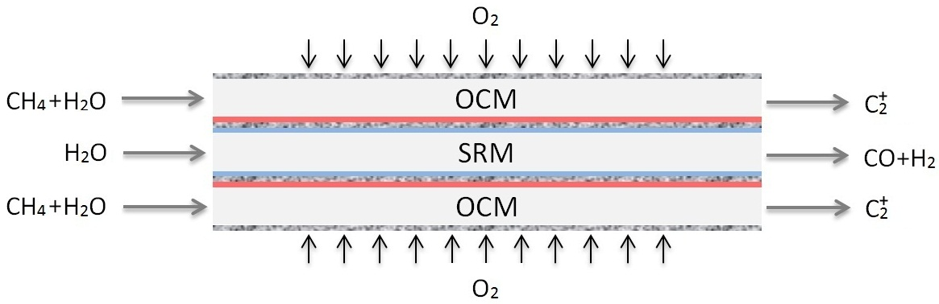

Hollow fiber catalytic membrane reactor
OCM
SRM
Hollow fiber dual function catalytic membrane reactor
  Core SRM
  Outer shell OCM
Easier and less complicated manufacturing

Slide 25
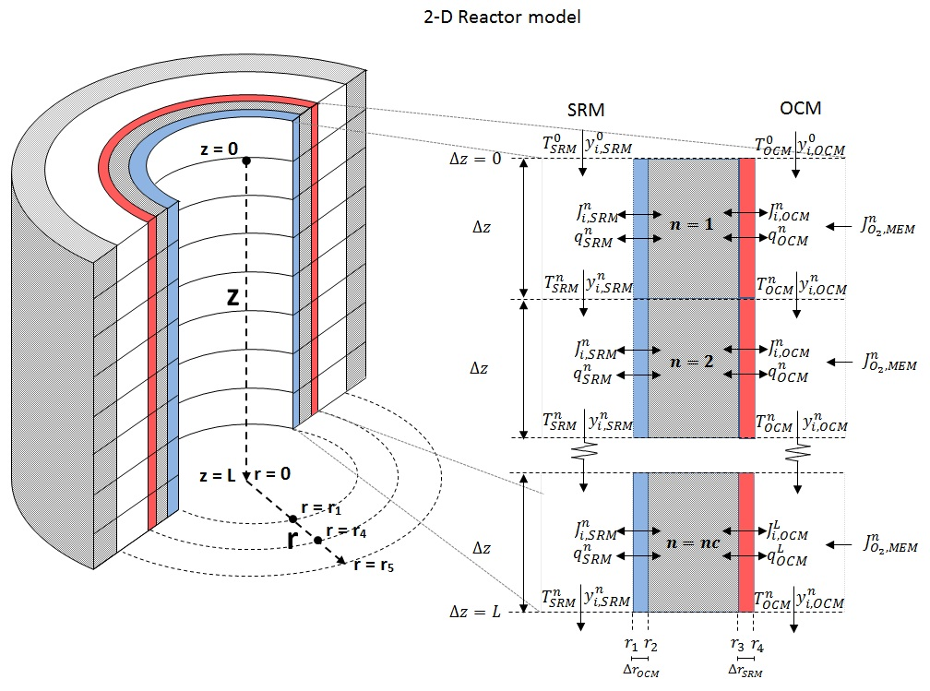
2-D reactor model
Hollow fiber model →Radial profiles
Reactor model → Hollow fiber model in series → Axial profiles

Slide 26
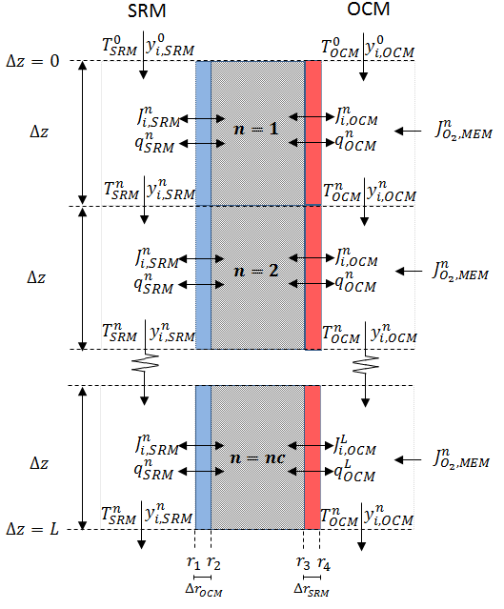
Assumptions
Isobaric conditions
No interphase mass and heat transfer limitations
No radial concentration profiles in the OCM and SRM compartments
Uniform oxygen distribution

Slide 27
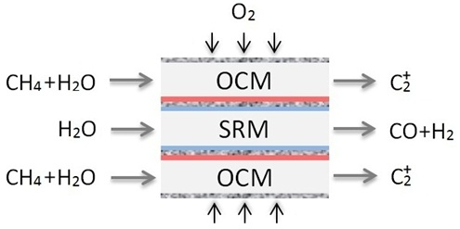

Cases
$$\frac{∂C}{∂r}=\frac{∂T}{∂r}=0$$
Only OCM Dual function

Slide 28
Outline
Introduction
Design of catalytic membrane reactor
  Packed bed membrane reactor
  Hollow fiber catalytic membrane reactor
Results
Conclusions

Slide 29
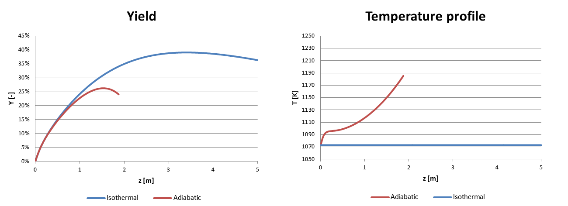
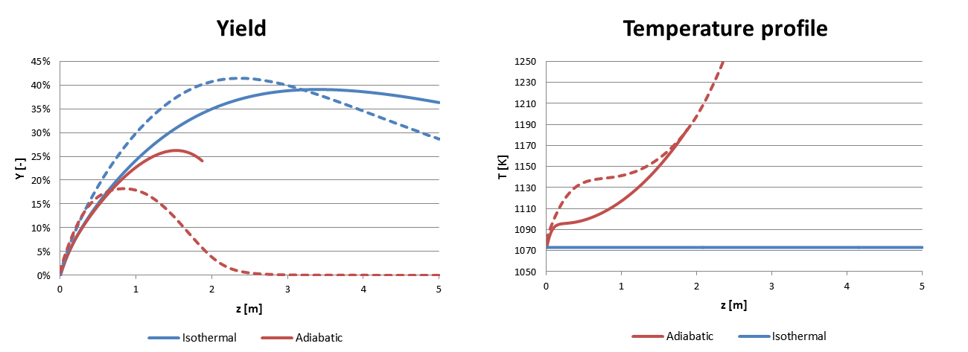
Only OCM: Packed bed vs. Hollow fiber
Hollow Fiber Reactor (Solid line) : Fixed bed reactor (dotted line)
C₂ Yield
  Isothermal: Packed bed (41%) > Hollow fiber (39%)
  Adiabatic: Packed bed (18%) < Hollow fiber (21%)
Hollow fiber reactor → better heat transfer effects

Slide 30
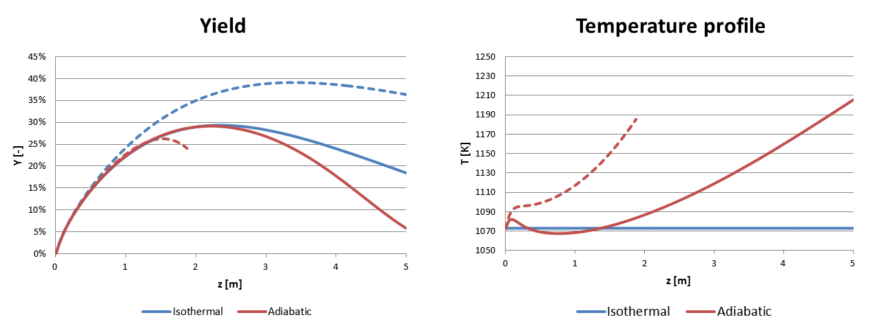
Hollow fiber: Dual function vs. only OCM
Dual function (Solid line) : Only OCM (dotted line)
C₂ Yield:
  Isothermal: Dual function (29%) < only OCM (39%)
  Adiabatic: Dual function (29%) > only OCM (27%)
Maximum yield: CH₄ conversion is 64% Vs 41% (Dual function Vs only OCM)

Slide 31
Conclusions
OCM / SRM integration in single multifunctional reactor
  Reactor performance:
  Hollow fiber catalytic membrane reactor > Packed bed membrane reactor
  Increased CH₄ conversion compared to only OCM
  Simultaneous production of C₂ and syngas without heat exchange equipment
Autothermal operation possible in both reactors
The models presented here could be useful to provide the guidelines for designing and improving the overall performance of the process
  Outlook
  Experimental demonstration

Slide 32
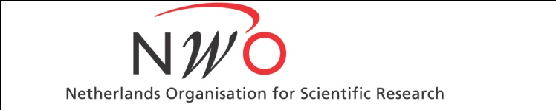

Acknowledgments
Thijs Kemp (HF model) and Jeroen Ramakers (experiments)
Collaborations
Prof. dr. Ir. Leon Lefferts (University of Twente, Netherlands)
Financial support from NWO/ASPECT is gratefully acknowledged

Slide 33
Thank you

Slide 34
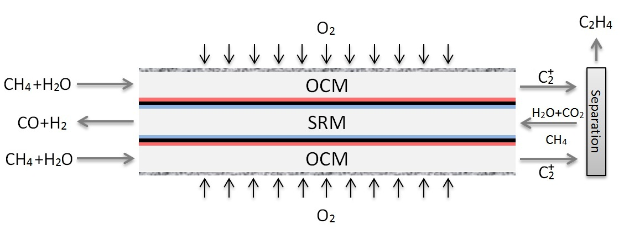
Recommendation
Dense Hollow fiber
In theory, 100% CH₄ conversion
Distribute the SRM catalyst locally
Syngas and ethylene are separated

